Slide 1
Composition: Balance

Slide 2
Composition: Leading Lines

Slide 3
Composition: Rule of Thirds

Slide 4
Composition: Viewpoint/Angles

Slide 5
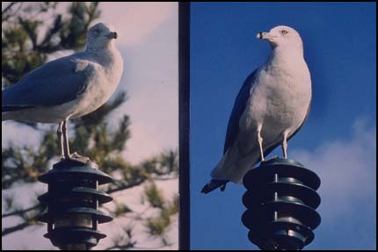
Composition: Simplicity

Slide 6
Composition: Framing

Slide 7
Composition: Fill the Frame

Slide 8
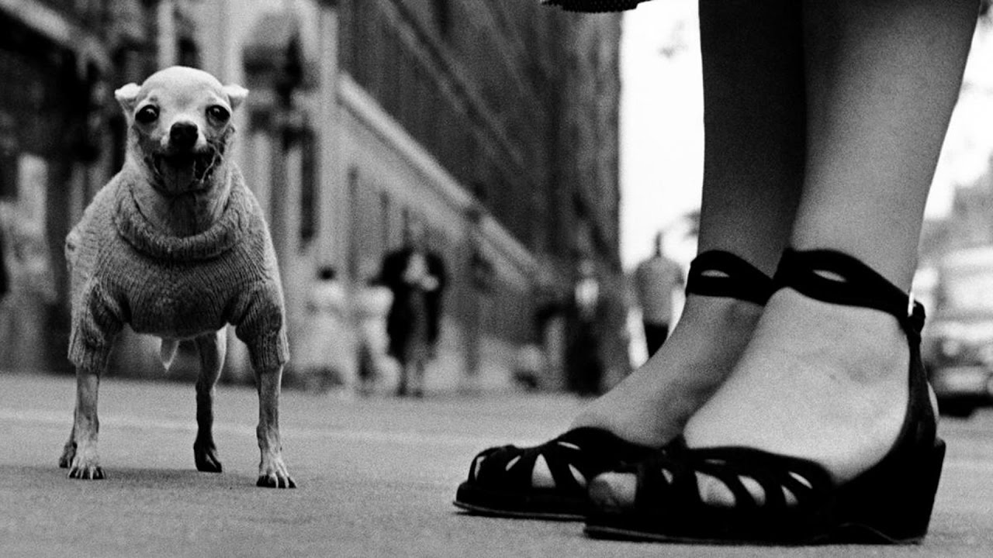
COMPOSITIONAL GUIDELINES
Viewpoints/Angles
Rule of thirds
Balance (Asymmetrical)
Framing
Leading Lines (above repetitive lines below s-curve)
Viewpoints/Angles
Busy v Simplicity
Balance (Symmetry)

